Slide 1
Chapter 3
STACKS AND QUEUES

Slide 2
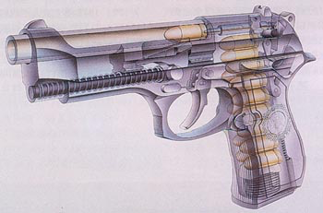


3.1 The Stack Abstract Data Type
Stack
  An ordered list in which insertions and deletions are made at one end called the top only.
  Last - In - First - Out ( L I F O )
  Stack S = (a₀, …, a_{n-1})
  a₀ -- the bottom element a_{n-1} -- the top element
6
5
6
5
4
3
5
2
6
1
栈（stack）是限定仅在表尾进行插入和删除操作的线性表。
栈又称为后进先出（Last In First Out）的线性表。

Slide 3



Example 1:
System stack after function call
f p
Old Frame Pointer
s p
Return Address
s p
Local Variables
s p
f p
f p
Stack Frame
s p
s p
Return Address
Notes:
浏览网页时候后退，word里面的撤销。

Slide 4
Stack Abstract Data Type
Structure Stack is
Object: a finite ordered list with zero or more elements.
Functions:
for all stack ∈ Stack, item ∈ element, max_stack_size ∈ positive integer
Stack CreateS(max_stack_size) ::=
create an empty stack whose maximum size is max_stack_size
Boolean IsFull(stack, max_stack_size) ::=
if ( number of elements in stack == max_stack_size )
return TRUE
else return FALSE
Stack Push(stack, item) ::=
if ( IsFull(stack) ) stack_full
else insert item into top of stack and return
Boolean IsEmpty(stack) ::=
if ( stack == CreateS(max_stack_size) ) return TRUE
else return FALSE
Element Pop(stack) ::=
if ( IsEmpty(stack) ) return
else remove and return the item on the top of the stack

Slide 5
Representation and Operations
Representation
  Stack CreateS ( max_stack_size ) ::=
  #define MAX_STACK_SIZE 100 /*maximum stack size */
  typedef struct {
  int key;
  /* other fields */
  } element;
  typedef struct {
  element data[ MAX_STACK_SIZE ];
  int top;
  } stack;
Operations
  Boolean IsEmpty(stack) ::= top < 0;
  Boolean IsFull(stack) ::= top >= max_stack_size - 1;
  Push to a stack
  Pop from a stack

Slide 6
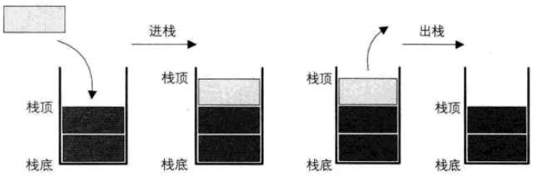
【example】
Push to a stack and Pop from a stack
int Push(element item)
{ /* add an item to the global stack */
if ( top >= MAX_STACK_SIZE -1 ) {
return FALSE;
}
S->data[++top] = item;
return TRUE;
}
int Pop(element *pX)
{ /* return the top element from the stack */
if ( top == -1 )
return FALSE;
*pX = S->data[top--];
return TRUE;
}

Slide 7
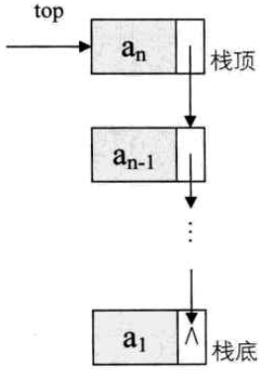
Representation and Operations
Representation in List
  Stack CreateS ( max_stack_size ) ::=
  typedef struct {
  int key;
  /* other fields */
  } element;
  typedef struct StackNode{
  element data;
  struct stackNode *next;
  } StackNode, *LinkStackPtr;
  typedef struct LinkStack{
  LinkStackPtr top;
  int count;
  } LinkStack;
Notes:
讲完了栈的顺序存储结构，我们现在来看看栈的链式存储结构，简称链栈。这里我们不使用头结点了。
对于链栈来说，基本不存在栈满的情况，除非内存已经没有可以使用的空间。如果是空栈的情况，top＝NULL。
栈的链式表达操作绝大部分都和单链表类似，只是在插入和删除上，特殊一些。

Slide 8
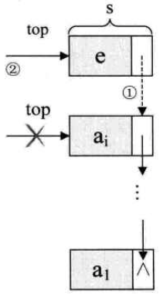
【example】
Push to a stack and Pop from a stack
int Push(LinkStack *S, element e)
{ /* add an item to the stack */
LinkStackPtr s=(LinkStackPtr)malloc(sizeof(StackNode));
s->data=e;
s->next=S->top;//把当前栈顶元素赋值给新结点的后继图(1).
S->top=s;//将新的结点s赋值给栈顶指针图(2).
S->count++;
return TRUE;
}

Slide 9
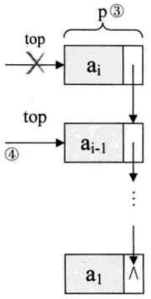
【example】
Push to a stack and Pop from a stack
int Pop(LinkStack *S, element *e)
{ /* remove the top element from the stack */
LinkStackPtr p;
if(StackEmpty(*S))
return FALSE;
*e=S->top->data;
p=S->top;//将栈顶结点赋值给p，如图(3).
S->top=S->top->next;//使得栈顶指针下移一位，如图(4).
free(p);
S->count--;
return TRUE;
}

Slide 10
顺序栈和链栈总结
顺序栈和链栈的进栈push和出栈pop操作都很简单，没有任何循环操作，时间复杂度均为O(1)。
对于空间性能，顺序栈需要事先确定一个固定的长度，可能会存在内存空间浪费的问题。如果栈的使用过程中元素变化不可预料，时大时小，那么最好是用链栈；反之，如果变化在可控范围内，建议使用顺序栈。
Notes:
顺序栈存取定位很方便。

Slide 11

3.1.2 Application of Stack
1 Recursion

Slide 12

3.1.2 Application of Stack
斐波那契数列实现
所经过的月数 | 1 | 2 | 3 | 4 | 5 | 6 | 7 | 8 | 9 | 10
兔子对数 | 1 | 1 | 2 | 3 | 5 | 8 | 13 | 21 | 34 | 55

Slide 13


3.1.2 Application of Stack
斐波那契数列实现
递归实现
int Fbi(int i)
{
if(i<2) return i==0?0:1;
return Fbi(i-1)+Fbi(i-2);
}
函数的局部变量
参数值
返回地址
Fbi(0)
Fbi(1)
递归调用栈
Fbi(2)
Notes:
编译器使用栈实现递归。递归过程中，每一层递归，函数的局部变量、参数值以及返回地址都被压入栈中

Slide 14

3.1.2 Application of Stack
2 Evaluation Of Expressions
Notes:
计算机没法计算带有括号，以及区分优先级的表达式，或者说很难计算。使用后缀，前缀，消除了括号和优先级。

Slide 15
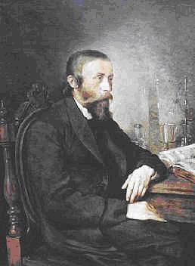
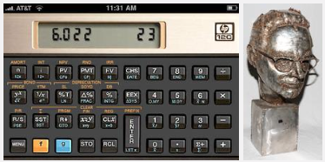
3.1.2 Application of Stack
2 Evaluation Of Expressions
前缀、后缀表达式
Jan Lukasiewicz想到了一种不需要括号的前缀、后缀表达式，
也称为波兰、逆波兰表示，完成四则运算。
Notes:
计算机没法计算带有括号，以及区分优先级的表达式，或者说很难计算。使用后缀，前缀，消除了括号和优先级。
20世纪50年代，波兰逻辑学家 卢卡西维茨，想到了一种不需要括号的前缀、后缀表达式，我们也称为波兰、逆波兰表示。

Slide 16
3.1.2
Evaluation Of Expressions
operand
operator
〖Example〗An infix expression: a + b ∗ c − d / e
A prefix expression: − + a ∗ b c / d e
A postfix expression: a b c ∗ + d e / −
Reverse Polish notation
operator
with the highest precedence
Token | Operator | precedence | associativity
( ) [ ] -> | function call array element struct or union | 17 | left-to-right
- - + + | increment. ,decre. postfix | 16 | left-to-right
- - + + ! ^ -- + & * sizeof | decrement. , incre. prefix logical not one's complement unaey minus or plus address or indirection size ( in bytes) | 15 | right-to-left
(type) | type cast | 14 | right-to-left
= += -= | assignment | 2 | right-to-left
, | comma | 1 | left-to-right
Notes:
计算机没法计算带有括号，以及区分优先级的表达式，或者说很难计算。使用后缀，前缀，消除了括号和优先级。

Slide 17
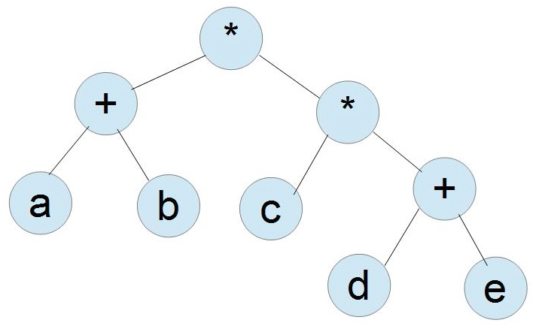
3.1.2
Evaluation Of Expressions
〖Example〗An infix expression: (a + b) ∗( c * (d + e))
A prefix expression: * + a b ∗ c + d e
A postfix expression: a b + c d e + * *
Notes:
计算机没法计算带有括号，以及区分优先级的表达式，或者说很难计算。使用后缀，前缀，消除了括号和优先级。

Slide 18
(1) Evaluating Postfix Expression
infix | Postfix
2 + 3 * 4 | 2 3 4 * +
a * b + 5 | a b * 5 +
( 1 + 2 ) * 7 | 1 2 + 7 *
a * b / c | a b * c /
((a/(b-c+d))*(e-a)*c | abc-d+/ea-*c*
a/b-c+d*e-a*c | ab/c-de*+ac*-
Notes:
中缀表达式是人喜欢的形式，符合人的思维习惯，后缀是机器喜欢的形式。所以，要让计算机计算四则运算要把中缀表达式变换成后缀表达式。

Slide 19
〖Example〗 6 2 / 3 − 4 2 ∗ + = ?
8
Get token: 6 ( operand )
Get token: 2 ( operand )
Get token: / ( operator )
Get token: 3 ( operand )
2
top
Get token: − ( operator )
Get token: 4 ( operand )
top
top
top
2
top
3
4
8
top
6
/
2
= 3
top
Get token: 2 ( operand )
Get token: ∗ ( operator )
top
top
top
top
top
6
top
3
0
8
top
3
−
3
= 0
top
top
top
Get token: + ( operator )
Pop: 8
top
+
= 8
top
4
∗
2
= 8
0
8

Slide 20
Program
Definition
  #define MAX_STACK_SIZE 100 /* maximum stack size */
  #define MAX_EXPR_SIZE 100 /* max size of expression*/
  typedef enum ( lparen, rparen, plus, minus, times, divide, mod, eos, operand ) precedence;
  char expr [ MAX_EXPR_SIZE ]; /* input string */
  typedef struct {
  int data[ MAX_STACK_SIZE ];
  int top;
  } stack; /* global stack */

Slide 21
Function to evaluate a postfix expression
#define MAX_STACK_SIZE 100 /* maximum stack size */
#define MAX_EXPR_SIZE 100 /* max size of expression*/
typedef enum { lparen, rparen, plus, minus, times, divide,
mod, eos, operand } precedence;
int stack [ MAX_STACK_SIZE ]; /* global stack */
char expr [ MAX_EXPR_SIZE ]; /* input string */
int eval ( void )
{ /* evaluate a postfix expression*/
precedence token;
char symbol; /* original character of token */
int op1, op2; /* operands */
int n = 0; /* counter for the expression string */
stack s;
s.top = −1;
int result;
token = get_token( &symbol, &n );
/* get one symbol and token type from expr [ n ] */
Notes:
enum枚举类型。

Slide 22
Function to evaluate a postfix expression
while ( token != eos ) { /* while it’s not the end of expr */
if ( token == operand )
push (&s, symbol); /* push the number into stack */
else {
pop ( &s,&op2); /* pop two operands */
pop ( &s, &op1);
switch ( token ) { /* perform operation and push result */
case plus: push ( &s, op1 + op2 ); break;
case minus: push ( &s, op1 − op2 ); break;
case times: push ( &s, op1 ∗ op2 ); break;
case divide: push ( &s, op1 / op2); break;
case mod: push ( &s, op1 % op2 );
} /* end switch */
} /* end else */
token = get_token (&symbol, &n); /* get the next token */
} /* end while-loop */
return pop ( &s, &result); /* return result */
}

Slide 23
Function to get a token from the input string
precedure get_token(char *symbol, int *n)
{
/* get the next token, symbol is the character representation, which is returned, the token is represented by its enumerated value, which is returned in the function name */
*symbol = expr[(*n)++];
switch ( *symbol ) {
case '( ' : return lparen;
case ' )' : return rparen;
case '+' : return plus;
case '-' : return minus;
case '/ ' : return divide;
case '*' : return times;
case '%' : return mod;
case ' ' : return eos;
default : return operand;/* no error checking, default is operand */
}
}

Slide 24

(2) Infix To Postfix
〖Example〗 a + b ∗ c − d = ?
a b c ∗ + d −
Note:
➢ The order of operands is the same in infix and postfix.
➢ Operators with higher precedence(优先级) appear before those with lower precedence.
Isn’t that
simple?
Output:
Wait till
you see the next
example...
a
b
c
∗
+
d
−
Get token: a (operand)
Get token: + (plus)
Get token: b (operand)
Get token: ∗ (times)
Get token: c (operand)
Get token: − (minus)
+ ≥ ∗ ?
∗
top
Get token: d (operand)
∗ ≥ − ?
+ ≥ − ?
top
top
+
top
−
top
top
top

Slide 25

§3 The Stack ADT
〖Example〗 a ∗ ( b + c ) / d = ?
a b c + ∗ d /
Output:
a
b
c
+
∗
d
/
Get token: a (operand)
Get token: ∗ (times)
Get token: ( (lparen)
Get token: b (operand)
+
top
Get token: + (plus)
Get token: c (operand)
top
∗ ≥ ( ?
(
top
Get token: ) (rparen)
Get token: / (divide)
( ≥ + ?
∗
top
/
top
top
Get token: d (operand)
∗ ≥ / ?
top
top
top
NO?!
T( N ) = O ( N )
规则：从左到右遍历中缀表达式的每个数字和符号，若是数字就输出，即成为后缀
表达式的一部分；若是符号，则判断其与栈顶符号的优先级，是右括号或优先级低于
或等于栈顶符号（乘除优先加减）则栈顶元素依次出栈操作符直到发现优先级更低的
元素位置，并将当前符号进栈，一直到最终输出后缀表达式为止。
Notes:
如果是左括号就进栈，右括号就依次出栈直到（出栈为止。

Slide 26


§3 The Stack ADT
Solutions:
① Never pop a ( from the stack except when processing a ) .
② Observe that when ( is not in the stack, its precedence is the highest; but when it is in the stack, its precedence is the lowest. Define in-stack precedence and incoming precedence (优先级) for symbols, and each time use the corresponding precedence for comparison.
Note: a – b – c will be converted to a b – c –. However, 2^2^3 ( ) must be converted to 2 2 3 ^ ^, not 2 2 ^ 3 ^ since exponentiation associates right to left.

Slide 27
Program postfix O(n)
void postfix(void)
{
char symbol;
precedence token;
int n = 0;
int top = 0; /* place eos on stack */
stack[0] = eos;
for ( token = get_token(&symbol, &n); token != eos; token =get_token(&symbol,&n) )
{
if ( token == operand ) printf("%c",symbol);
else if ( token == rparen ) { /* unstack tokens until left parenthesis */
while ( stack[top] != lparen )
print_token(pop(&top));
pop(&top); /* discard the left parenthesis */
}
else {//栈顶优先级低于或等于栈顶符号，则栈顶元素依次出栈操作符直到发现优先级更低的元素位置，并将当前符号进栈。
while ( isp[stack[top]] >= icp[token] )
printf_token(pop(&top));
push(&top, token);
}
}
while ( (token=pop(&top)) != eos ) print_token(token);//将栈中符号全部出栈并输出
printf("\n");
}

Slide 28

3.2 The Queues Abstract Data Type
4
Queue
  An ordered list in which all insertions take place at one end and all deletions take place at the opposite end.
  First - in - First - Out (FIFO)
  queue Q = (a₀, …, a_{n-1})
  a₀ -- the front element
  a_{n-1} -- the rear
3
2
1
2
1
队列（queue）是只允许在一端进行插入操作，
而在另一端进行删除操作的线性表。
队列是一种先进先出（First In First Out）的线性表。
2
1
Notes:
队列在程序设计中用得非常频繁。比如用键盘进行各种字母或数字的输入，到显示器上如记事本软件上的输出，其实就是队列的典型应用。

Slide 29
Queue Abstract Data Type
structure Queue is
object: a finite ordered list with zero or more elements.
functions:
for all queue∈ Queue, item∈ element, max_queue_size∈ positive integer
Queue CreateQ(max_queue_size) ::=
create an empty queue whose maximum size is max_queue_size
Boolean IsFullQ(queue, max_queue_size) ::=
if ( number of elements in queue == max_queue_size ) return TRUE
else return FALSE
Queue AddQ(queue, item) ::=
if ( IsFullQ(queue) ) queue_full
else insert item at rear of queue and return queue
Boolean IsEmptyQ(queue) ::=
if ( queue == CreatQ(max_queue_size) ) return TRUE
else return FALSE
Element DeleteQ( queue) ::=
if ( IsEmptyQ( queue ) ) return
else remove and return the item at front of queue

Slide 30
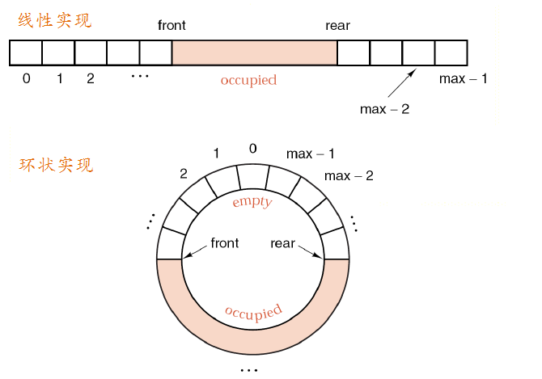
Representation and Operations
Notes:
队列的顺序存储有两种形式：线性队列和循环队列。

Slide 31
Representation and Operations
Representation
  Queue CreateQ ( max_queue_size ) ::=
  #define MAX_QUEUE_SIZE 100 /*maximum queue size */
  typedef struct {
  int key;
  /* other fields */
  } element;
  typedef struct{
  element data[ MAX_QUEUE_SIZE ];
  int rear;
  int front;
  } queue
Operations
  Boolean IsEmptyQ(queue) ::= front == rear;
  Boolean IsFullQ(queue) ::= rear == max_queue_size - 1;
  Add to a queue
  Delete from a queue

Slide 32
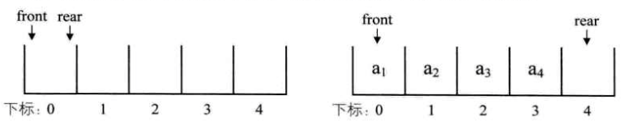
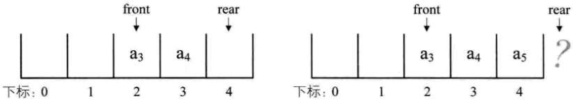
【example】
Add to a queue and Delete from a queue
Int addq(element item)
{ /* add an item to the queue */
if ( rear == MAX_QUEUE_SIZE -1 ) {
return FALSE;
}
queue[rear++] = item;
return TRUE;
}
int deleteq(int rear)
{ /* remove element at the front of the queue */
if ( front == rear )
return FALSE;
element item queue[front++];
return TRUE;
}
假溢出
Notes:
假设这个队列的总个数不超过5个，但目前如果接着入队的话，因数组末尾元素已经占用，再向后加，就会产生数组越界的错误，可实际上，我们的队列在下标为0和1的地方还是空闲的。我们把这种现象叫做“假溢出”。
现实当中，你上了公交车，发现前排有两个空座位，而后排所有座位都已经坐满，你会怎么做？立马下车，并对自己说，后面没座了，我等下一辆？肯定不会这么笨的，前面有座位，当然可以坐前面的，除非坐满了，才会考虑下一辆。

Slide 33
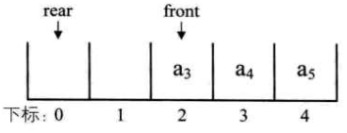
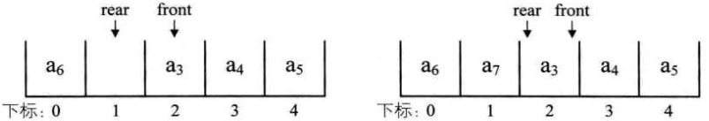
【example】
Add to a queue and Delete from a queue
Notes:
此时问题又出来了，我们刚才说，空队列时，front等于rear，现在当队列满时，也是front等于rear，那么如何判断此时的队列究竟是空还是满呢？

Slide 34

【example】Job scheduling
−1
0
1
2
3
4
5
6
Job 1
Job 2
Job 3
Job 4
Job 5
Job 6
Job 7
front
rear
rear
rear
rear
rear
rear
rear
front
 addq Job 1
 addq Job 2
 addq Job 3
 delq Job 1
 addq Job 4
 addq Job 5
 addq Job 6
 delq Job 2
 addq Job 7
 addq Job 8
queue_full ( ) ::= move the entire queue to the left, so that the first element is again at queue [ 0 ], front is at −1, and rear is also correctly positioned.
The worst case T_{queue_full} = O( MAX_QUEUE_SIZE )

Slide 35
Circular Queues
rear
[ 5 ]
[ 0 ]
rear
front
rear
Question:
Why is the queue
announced full
while there is
still a free
space left?
rear
 addq Job 1
front
Job
5
Job
6
 addq Job 2
rear
Do you have
a better idea?
front
Are you kidding?
Of course I do!
rear
 addq Job 3
Job
4
Job
1
[ 4 ]
[ 1 ]
 delq Job 1
 addq Job 4
Job
3
Job
2
 addq Job 5
rear
rear
The queue
is full
 addq Job 6
The queue
is full
[ 3 ]
[ 2 ]
 addq Job 7
Note: We should rotate rear and front before we push or pop any item.

Slide 36
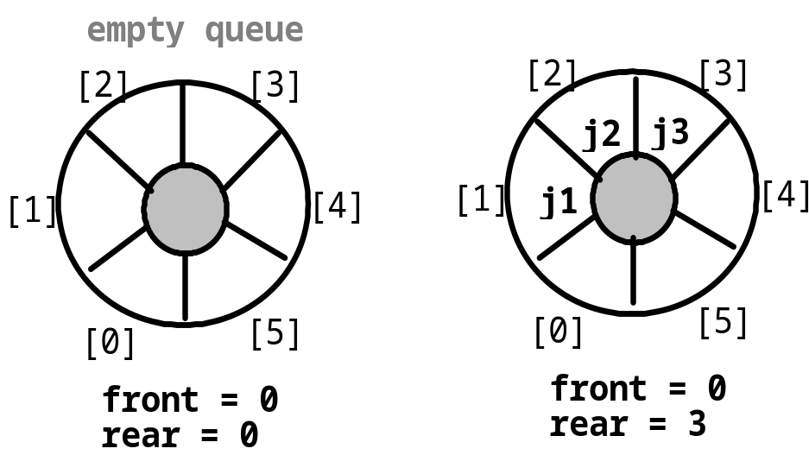
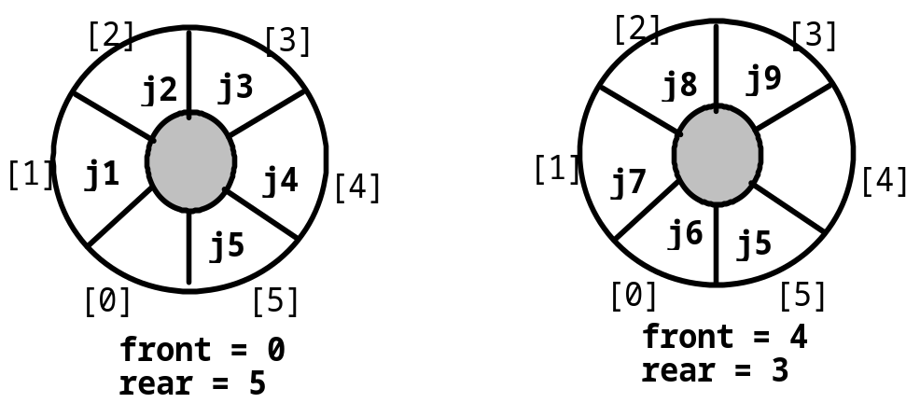
Circular Queues
front ==rear (empty queue )
front ==(rear +1)%max ( full queue )
Queue CreateQ( max_queue_size )::=
#define MAX_QUEUE_SIZE 100
typedef struct {
int key ;
/* other fields */
} element ;
element queue [ MAX_STACK_SIZE ] ;
int rear = 0, front = 0 ;
*rear = (*rear + 1) % MAX_AUEUE_SIZE;
*front = (*front+1) % MAX_QUEUE_SIZE;

Slide 37
【example】
Add to a circular queue and delete
int addq(int front, int *rear, element item)
{ /* add an item to the queue */
*rear = (*rear+1) % MAX_QUEUE_SIZE;
if ( front == *rear ) {
return FALSE; /* The queue is full.*/
}
queue[*rear] = item;
return TRUE;
}
int deleteq(int *front, int rear, element *pX)
{/* remove front element from the queue and put it in item */
element item;
if ( *front == rear )
return FALSE; /* The queue is empty.*/
*front = (*front+1) % MAX_QUEUE_SIZE;
*pX = queue[*front];
return TRUE;
}

Slide 38
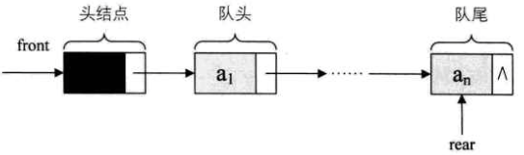
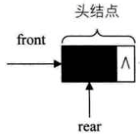
Representation and Operations
typedef int QElemType;
typedef struct Qnode
{
QElemType data;
struct Qnode *next;
} Qnode, *QueuePtr;
typedef struct
{
QueuePtr front, rear;
} LinkQueue;
Notes:
队列的链式存储结构，其实就是线性表的单链表，只不过它只能尾进头出而已，我们简称为链队列。
为了操作上方便，我们将队头指针指向链队列的头结点，而队尾指针指向终端结点。
空队列时，front和rear都指向头结点。

Slide 39
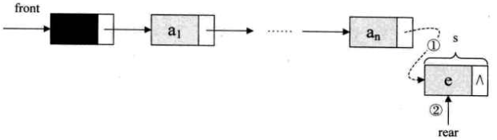
Representation and Operations
Status EnQueue(LinkQueue *Q, QElemType e)
{
QueuePtr s=(QueuePtr) malloc(sizeof(Qnode));
if(!s) exit(OVERFLOW);
s->data=e;
s->next=NULL;
Q->rear->next=s;//把新结点s赋给尾结点的后继，如图（1）。
Q->rear=s;//把当前的s设置为队尾结点，rear指向s，如图（2）。
return OK;
}
Notes:
队列的链式存储结构，其实就是线性表的单链表，只不过它只能尾进头出而已，我们简称为链队列。
为了操作上方便，我们将队头指针指向链队列的头结点，而队尾指针指向终端结点。
空队列时，front和rear都指向头结点。

Slide 40
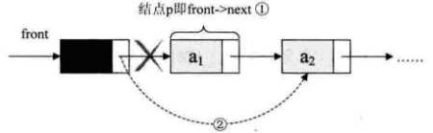
Representation and Operations
(3)
rear
Status DeQueue(LinkQueue *Q, QElemType e)
{
QueuePtr p;
if(Q->front==Q->rear) return ERROR;
p=Q->front->next;//将欲删除的队头结点暂存给p，如图（1）。
*e=p->data;//将欲删除的队头结点的值赋给e。
Q->front->next=p->next;//将原队头结点后继赋给当前头结点后继，如图（2）。
if(Q->rear==p) Q->rear=Q->front;//若是队头是队尾，则删除后将rear指向头结点。
free(p);
return OK;
}
Notes:
队列的链式存储结构，其实就是线性表的单链表，只不过它只能尾进头出而已，我们简称为链队列。
为了操作上方便，我们将队头指针指向链队列的头结点，而队尾指针指向终端结点。
空队列时，front和rear都指向头结点。

Slide 41
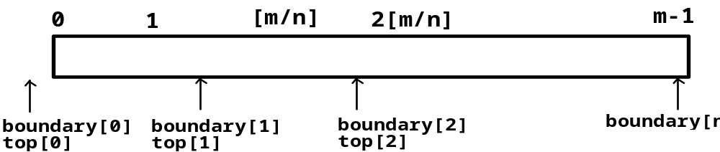
3.5 Multiple Stacks and Queues
Definition
  #define MEMORY_SIZE 100 /* size of memory */
  #define MAX_STACKS 10 /* max number of stacks plus 1*/
  element memory [ MEMORY_SIZE ]; /* global memory declaration */
  int top [ MAX_STACKS ];
  int boundary [ MAX_STACKS ];
  int n ; /* number of stacks entered by the user */
All stacks are empty and divided into roughly equal segments
  top [ 0] = boundary [ 0] = -1;
  for ( i = 1; i < n; i ++ )
  top [ i ] = boundary [ i ] = (MEMORY_SIZE / n ) * i;
  boundary [n ] = MEMORY_SIZE -1;

Slide 42
Push an item to the stack stack_no
Pop an item from the stack stack_no
int Push(int i, element item)
{ /* add an item to the ith stack */
if ( top[i] == boundary[i+1] )
return FALSE;
memory[++top[i]] = item; return TRUE;
}
int Pop(int i, element *pX)
{ /* remove top element from the ith stack */
if ( top[i] == boundary[i] )
return FALSE;
*pX = memory[top[i] -- ]; return TRUE;
}
！Configuration when stack i meet stack i =1, but the memory is not full
b[0] t[0] b[1] t[1] b[i] t[i] t[i+1] t[j] b[j+1] b[n]
b[i+1] b[i+2]

